Slide 1
Beware of the Dark Web – How to Properly Control Web Circumvention
Angie Becker – Network Manager
Kenosha Unified School District
Keith Ebner – Systems Support Specialist
Kenosha Unified School District

Slide 2
Kenosha Unified School District
Overview
41 total schools
Over 43,000 Networked Devices
Over 21,000 students
Over 4,200 employees
Key Requirements for filtering
CIPA compliant
Ease of access
Granularity and Scalability
Visibility (Decrypting)
Real time monitoring as well as historical

Slide 3
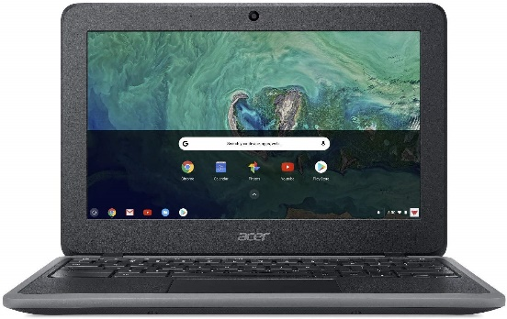
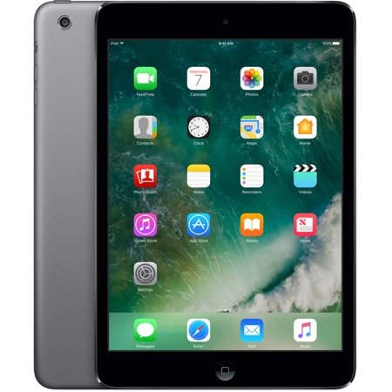
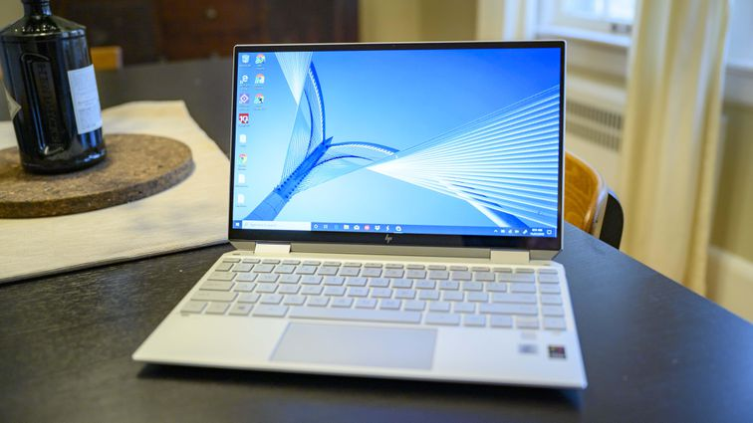
Student Technology Resources
19,000+ Chromebooks
6,000+ iPads
8,000+ Windows Laptops and Desktops
1,500 Apple Desktops and Laptops

Slide 4
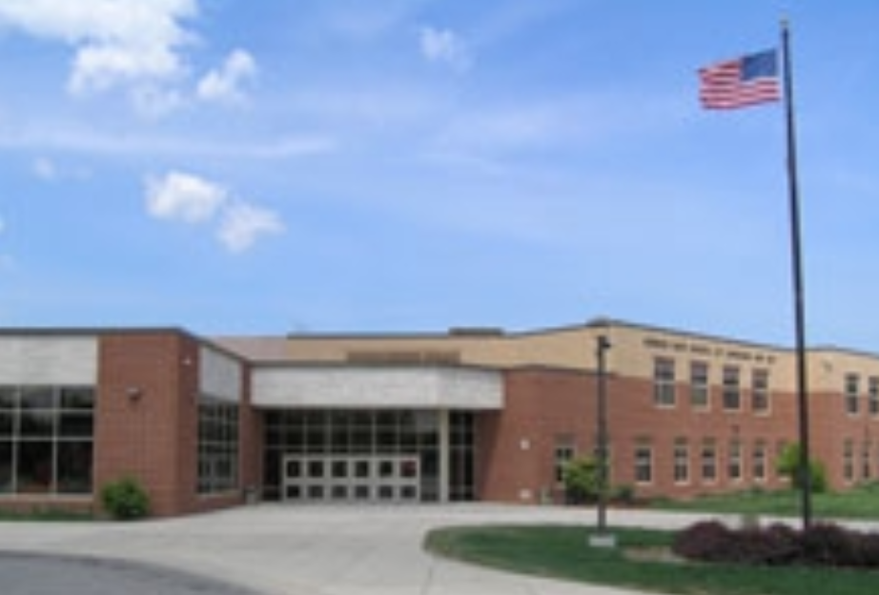
Technology Support Structure
Building-level support is divided into four regions based on geographical locations, mostly consisting of the following:
1 Large High School
1-2 Middle Schools
4-5 Elementary Schools
1 Choice/Charter School
27 technicians throughout the district for “first-level” support.

Slide 5
Infrastructure Overview
Currently, KUSD has 10 Gb Dark fiber between 5 Core sites with 2 separate 10 Gb fiber connections to remote sites.
Each remote site connects to 2 separate “core” switches for redundancy.
One dedicated 10 Gb fiber to disaster recovery site.
Currently support over 450 network stacks.
Peaking around 2Gb per day.

Slide 6
Preventative and Proactive Measures
ContentKeeper Content Filter
Firewall
Monitoring Software
Anti-virus
Updated Staff Acceptable Use Policy
Updated Student Acceptable Use Policy

Slide 7
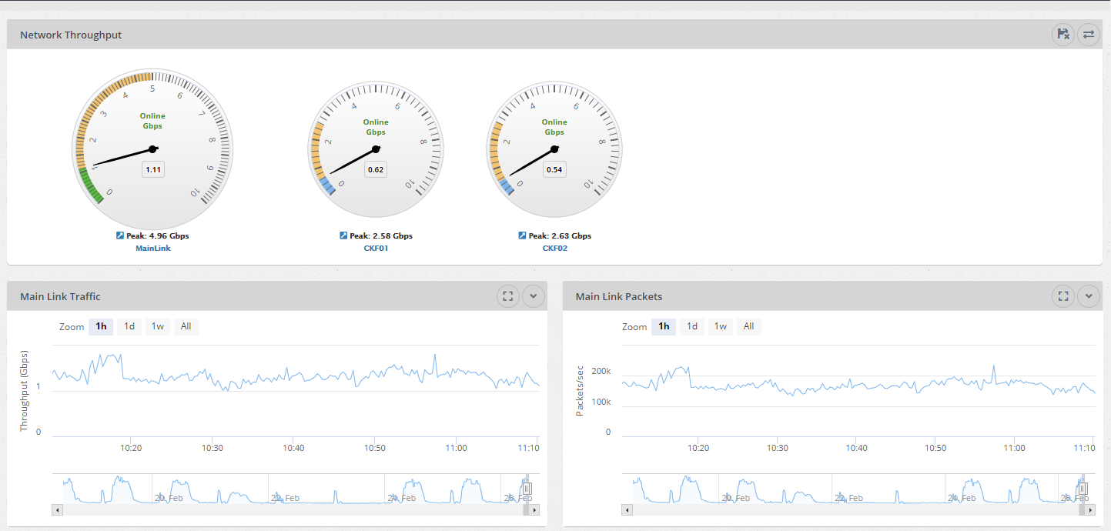
ContentKeeper Configuration
One reporting Server
Load Balancer
Two Internal Content Filters
One Mobile Filter

Slide 8
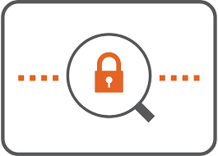
Policies
Policies are associated with Active Directory.
If filter doesn’t know who you are in AD; managed through assigned VLAN.
Tie in with our Google domain through an extension.
Software running on domain controller to associate Google Gmail with an AD account in order to get the correct policy.
If filter does not know who you are…… you get the most restrictive policy.
Ultimately, AD wins.

Slide 9
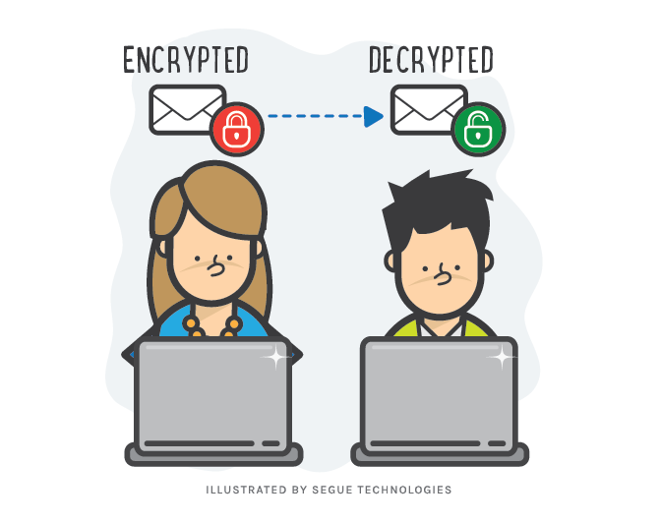
SSL Decryption
Benefited from SSL Decryption
Decrypt Google images
Get Granular with Decryption – do not decrypt banking or healthcare sites
Previous content filter did not decrypt properly
Certificates needed on all devices for SSL to work
Disable it within certain policies (i.e. Android certificate issues)

Slide 10
The Dark Web
The part of the World Wide Web that is only accessible by means of special software, allowing users and website operators to remain anonymous or untraceable.

Slide 11
"The Onion Router” - TOR
Free and open-source software for enabling anonymous communication.
The name is derived from an acronym for the original software project name "The Onion Router".
Makes it difficult to trace user Internet activity including "visits to websites, online posts, instant messages, and other communication forms".
Intended to protect the personal privacy of its users, as well as their freedom and ability to conduct confidential communication.

Slide 12
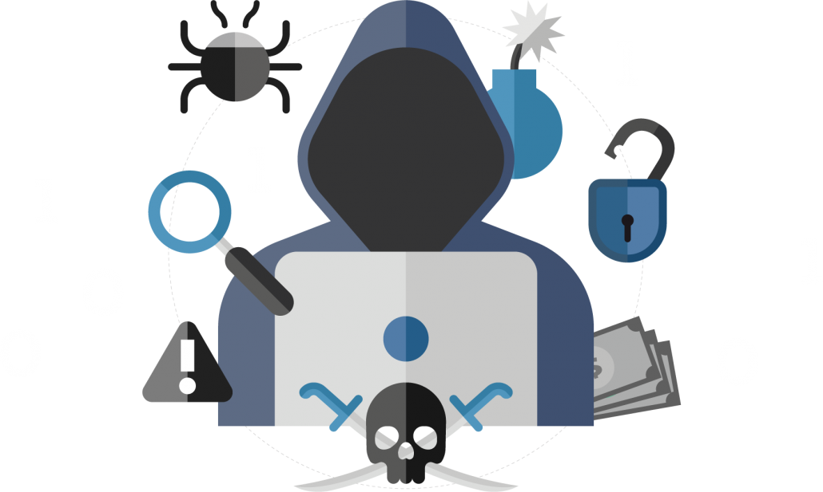
Why Do These Systems Exist?
Journalists
Whistleblowers
Political Protesters
Anti-Censorship Advocacy Groups
Residents of Oppressive Political Regimes

Slide 13
Dark Web Content:
Drugs
Illegal Pornography
Crime
Hacking
Anonymous Communication

Slide 14
Dark Web: Running Rampant in K-12
Bad Apps:
Tor
Psiphon
Purpose:
Anonymize
Gaming
Videos
Crime
Cheating
Drugs
Malware

Slide 15
Web Anonymity = Access Bad Stuff…
Underage Students Get Direct Access To:
Drugs
Pornography
Illegal Movie Streaming
Malicious Websites
Pirated Music Sites
Gaming Sites

Slide 16
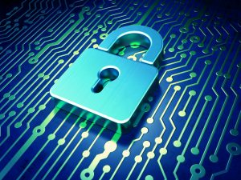
Levels of Defense
Application Firewall
End-Point Security
Advanced Network Web Filter
Focus on bad-app signatures
See all ports
Successful SSL decode
Keyword and phrase intelligence
Logging, reporting and alerting
Automated user-activity reporting

Slide 17
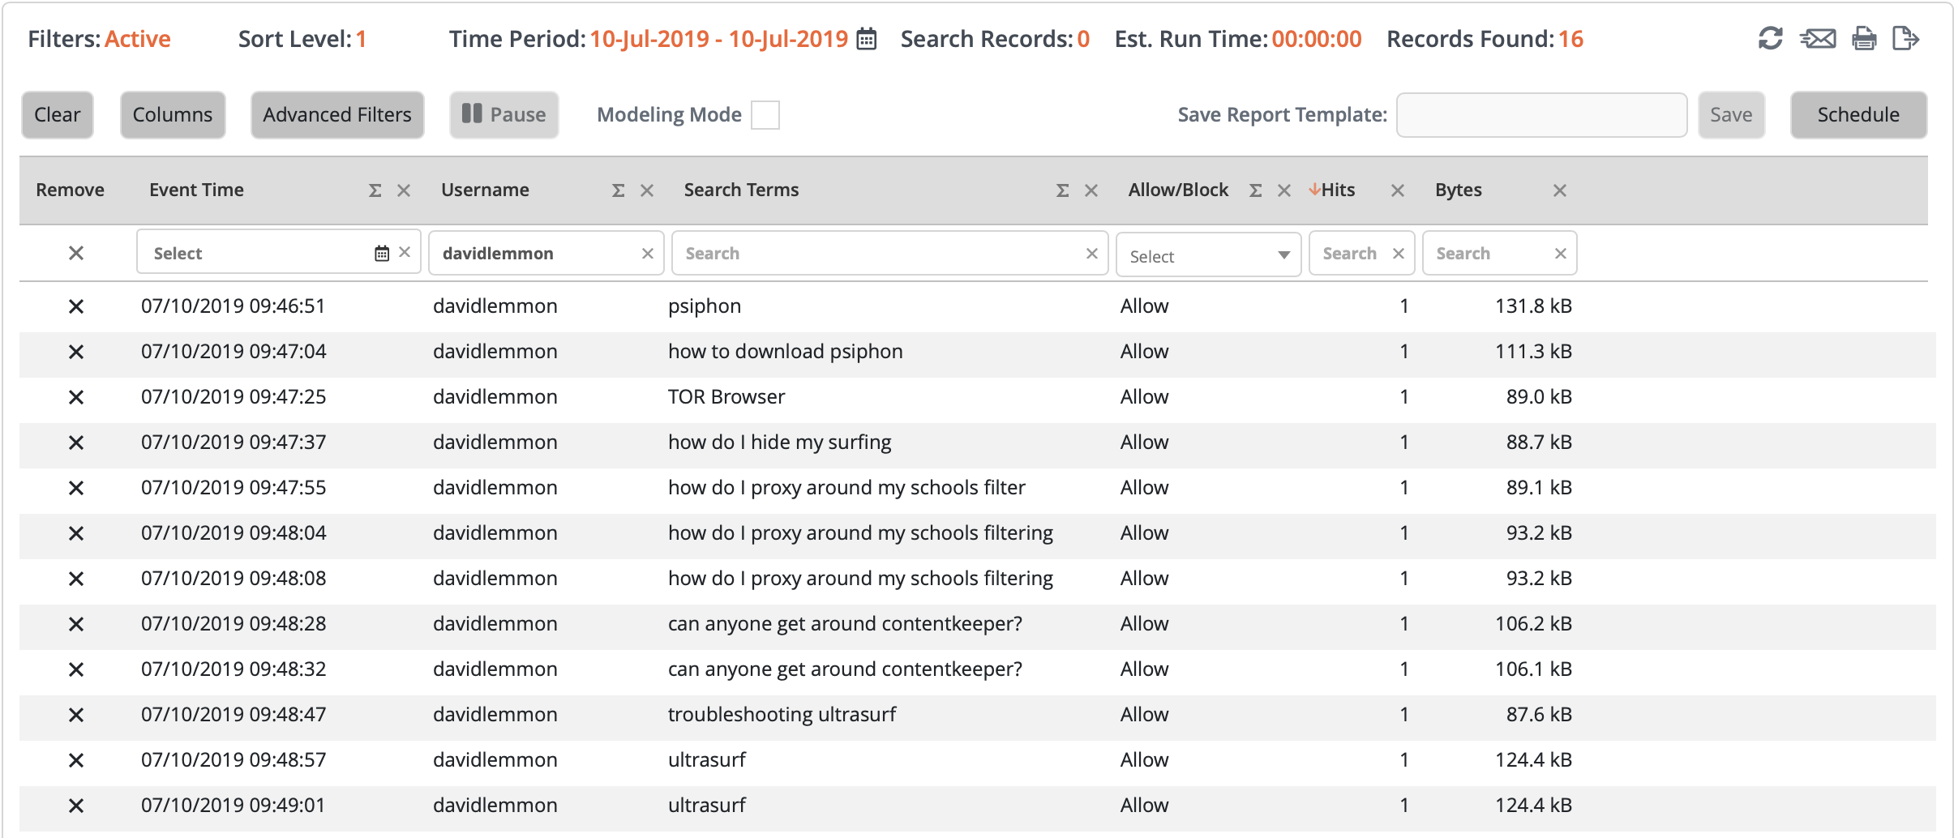
Keyword and Phrase Awareness

Slide 18
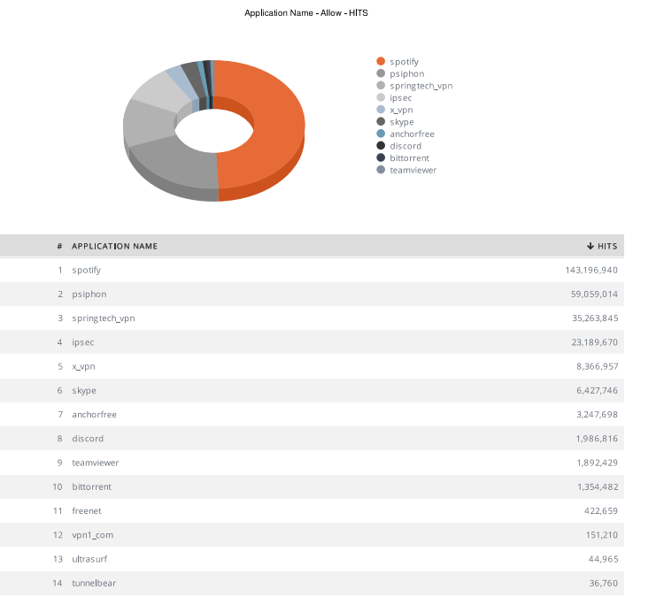

Slide 19
The Why………
Web Circumvention is a direct violation of KUSD’s Student Acceptable Use Policy and a threat to CIPA, FERPA and others.
Students use several methods to set-up “unmonitored” paths directly through the filter.
Bandwidth usage takes a huge hit as students access applications via private tunnels, peer to peer, SSL proxies and others.
Excerpt from email sent to parents and students regarding circumventing district filter:
“As stated in the Student Acceptable Use Policy 6633, Students shall not breach or disable network security mechanisms or compromise network stability or security in any way, in other words, circumventing district security is considered a violation of this policy. That being said, if a student owned device accesses the district wireless/wired environment, it will be treated in the same manner as any district device, which includes filtering and restricting access. KUSD uses a variety of tools to ensure compliant internet filtering and any device on the KUSD network will be filtered, monitored and restricted in accordance with our security profiles.”
Notes:
Bidirectional path – here comes the Ransomware

Slide 20
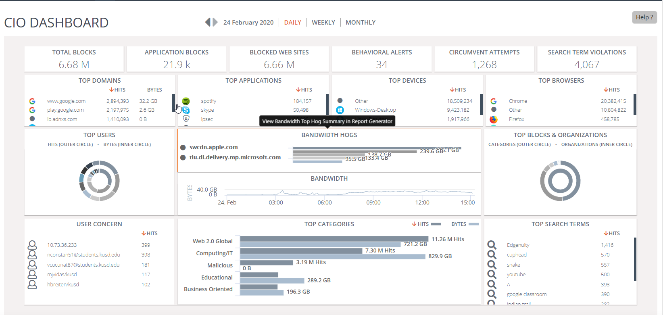
Dashboard for KUSD

Slide 21
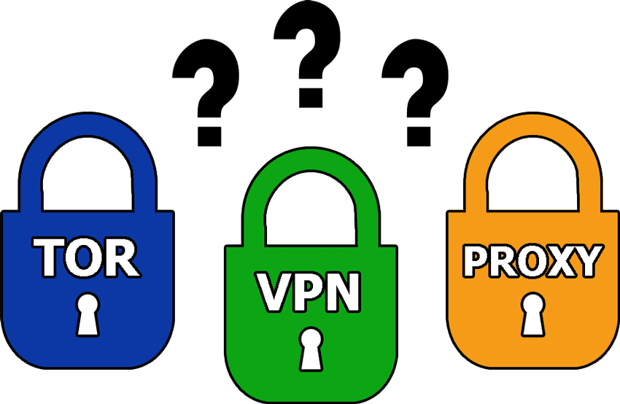
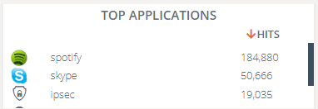
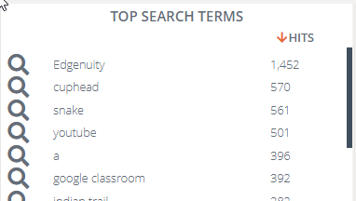
Potential Risks….Exposed!

Slide 22
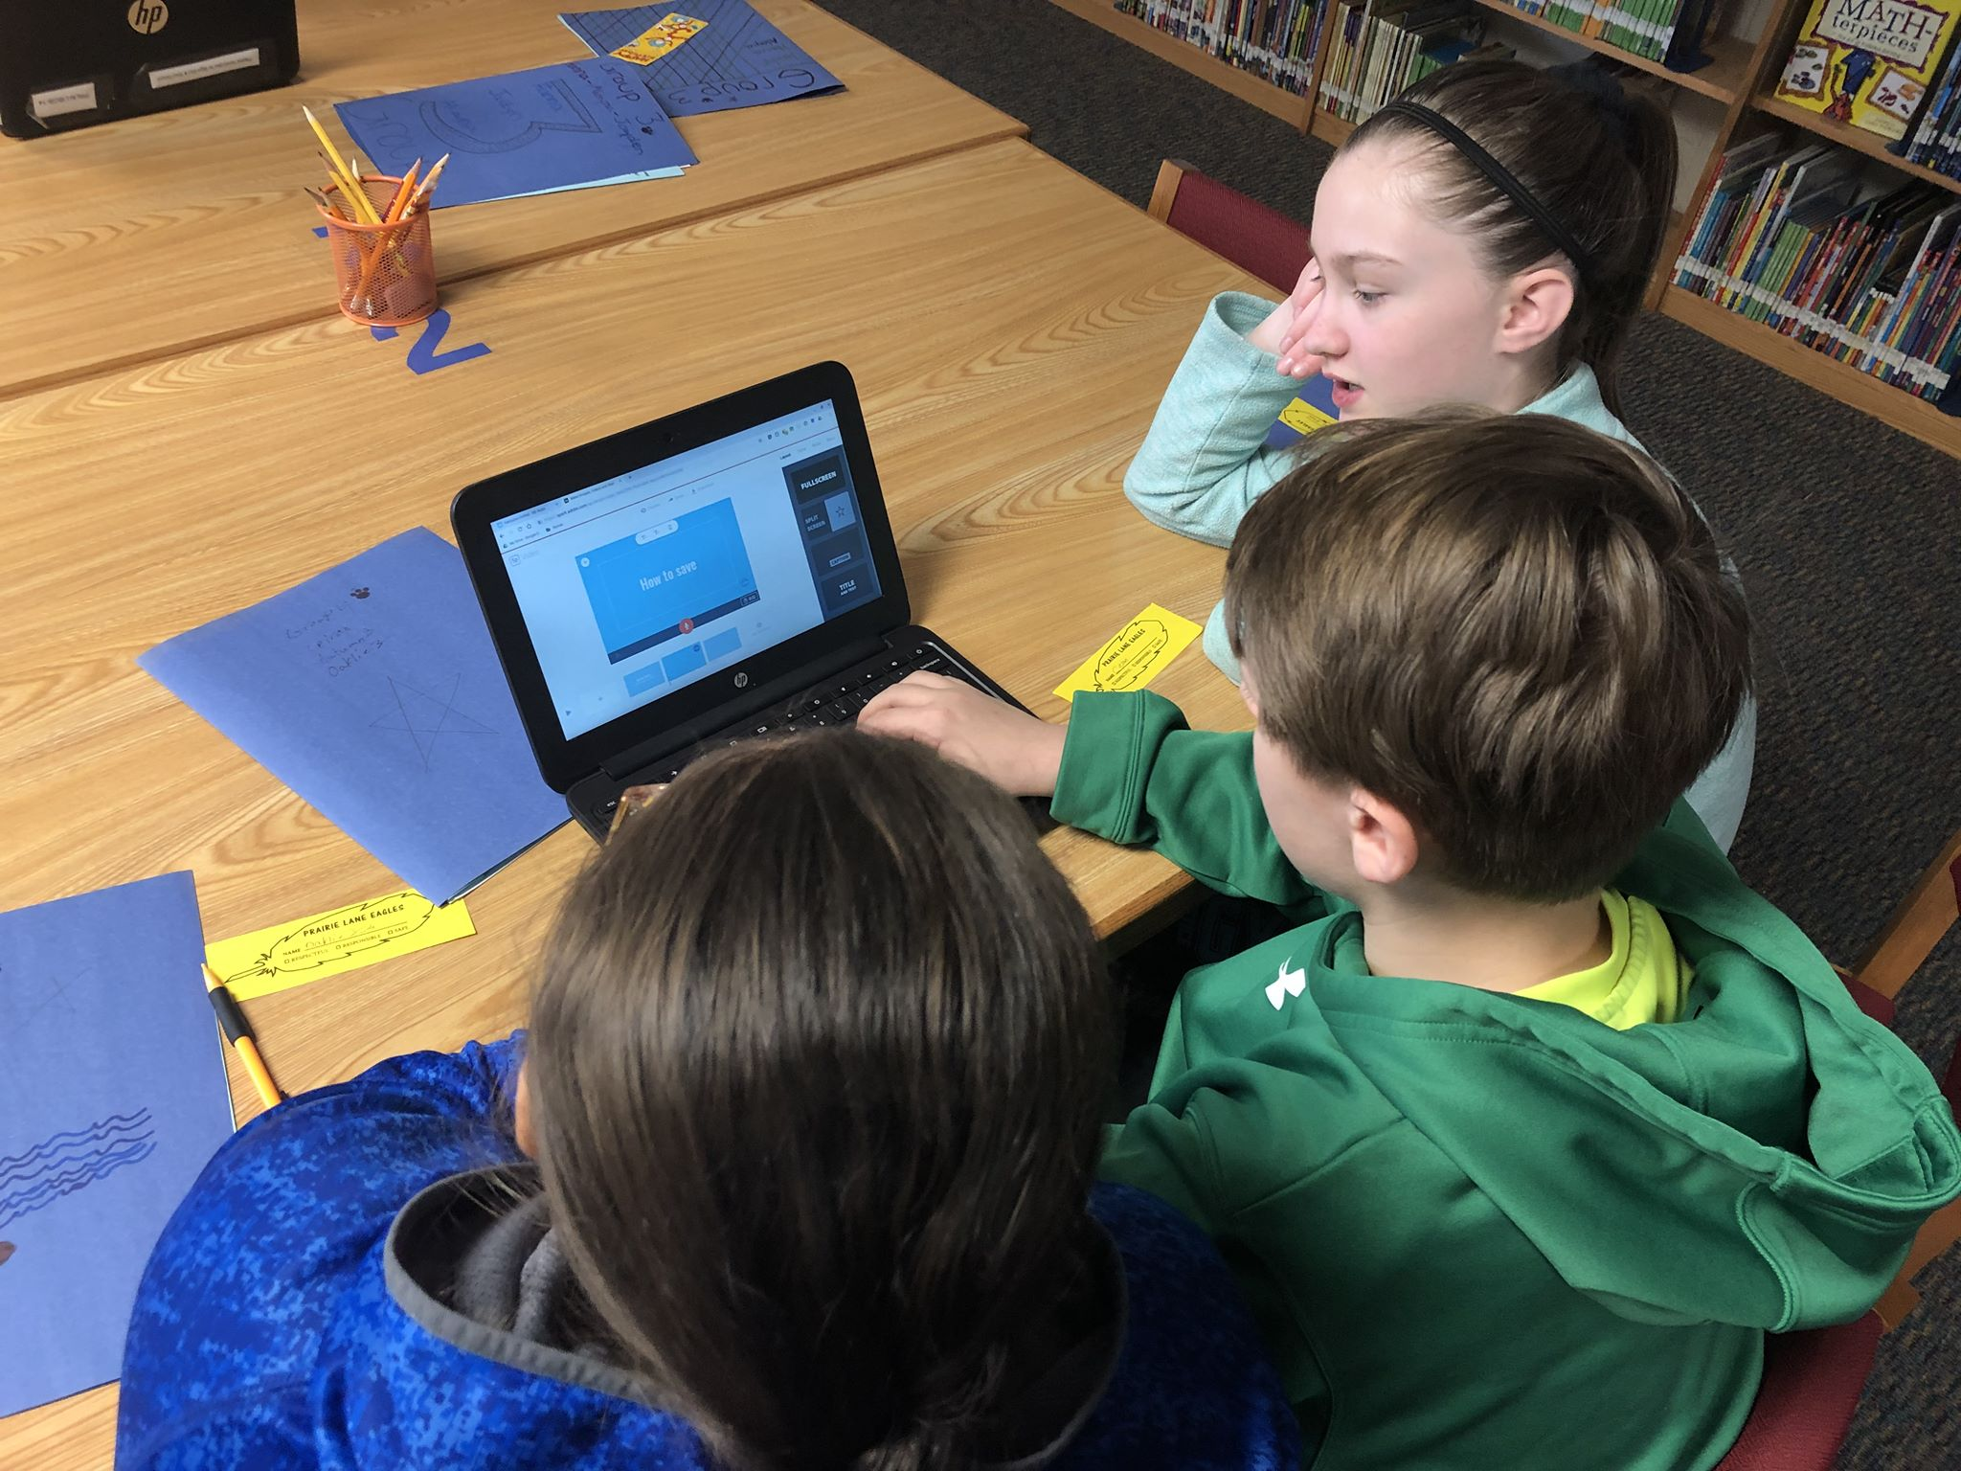
Granular within Policies

Slide 23
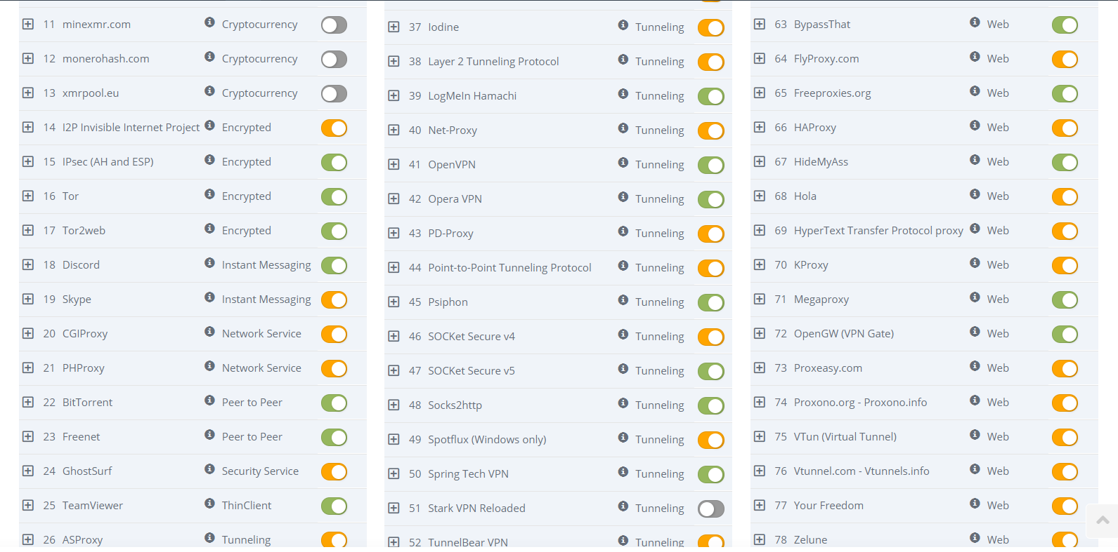
Signatures for Bad Apps……. It’s Growing!!!!

Slide 24
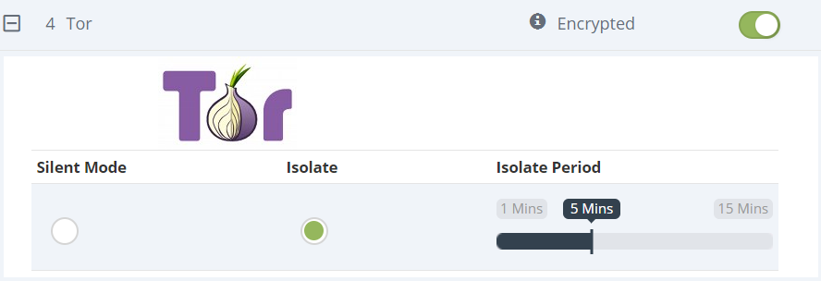
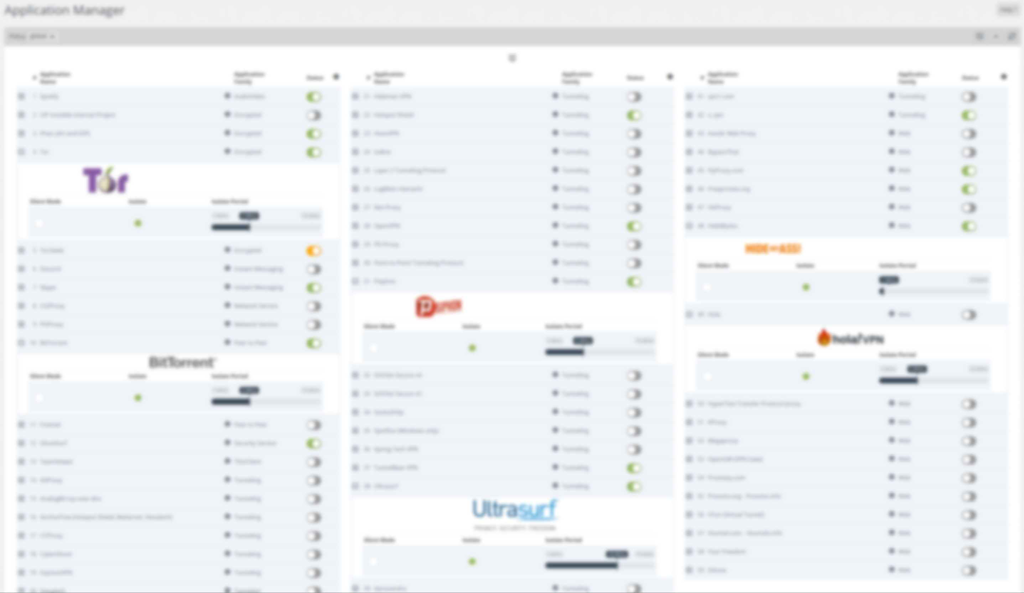
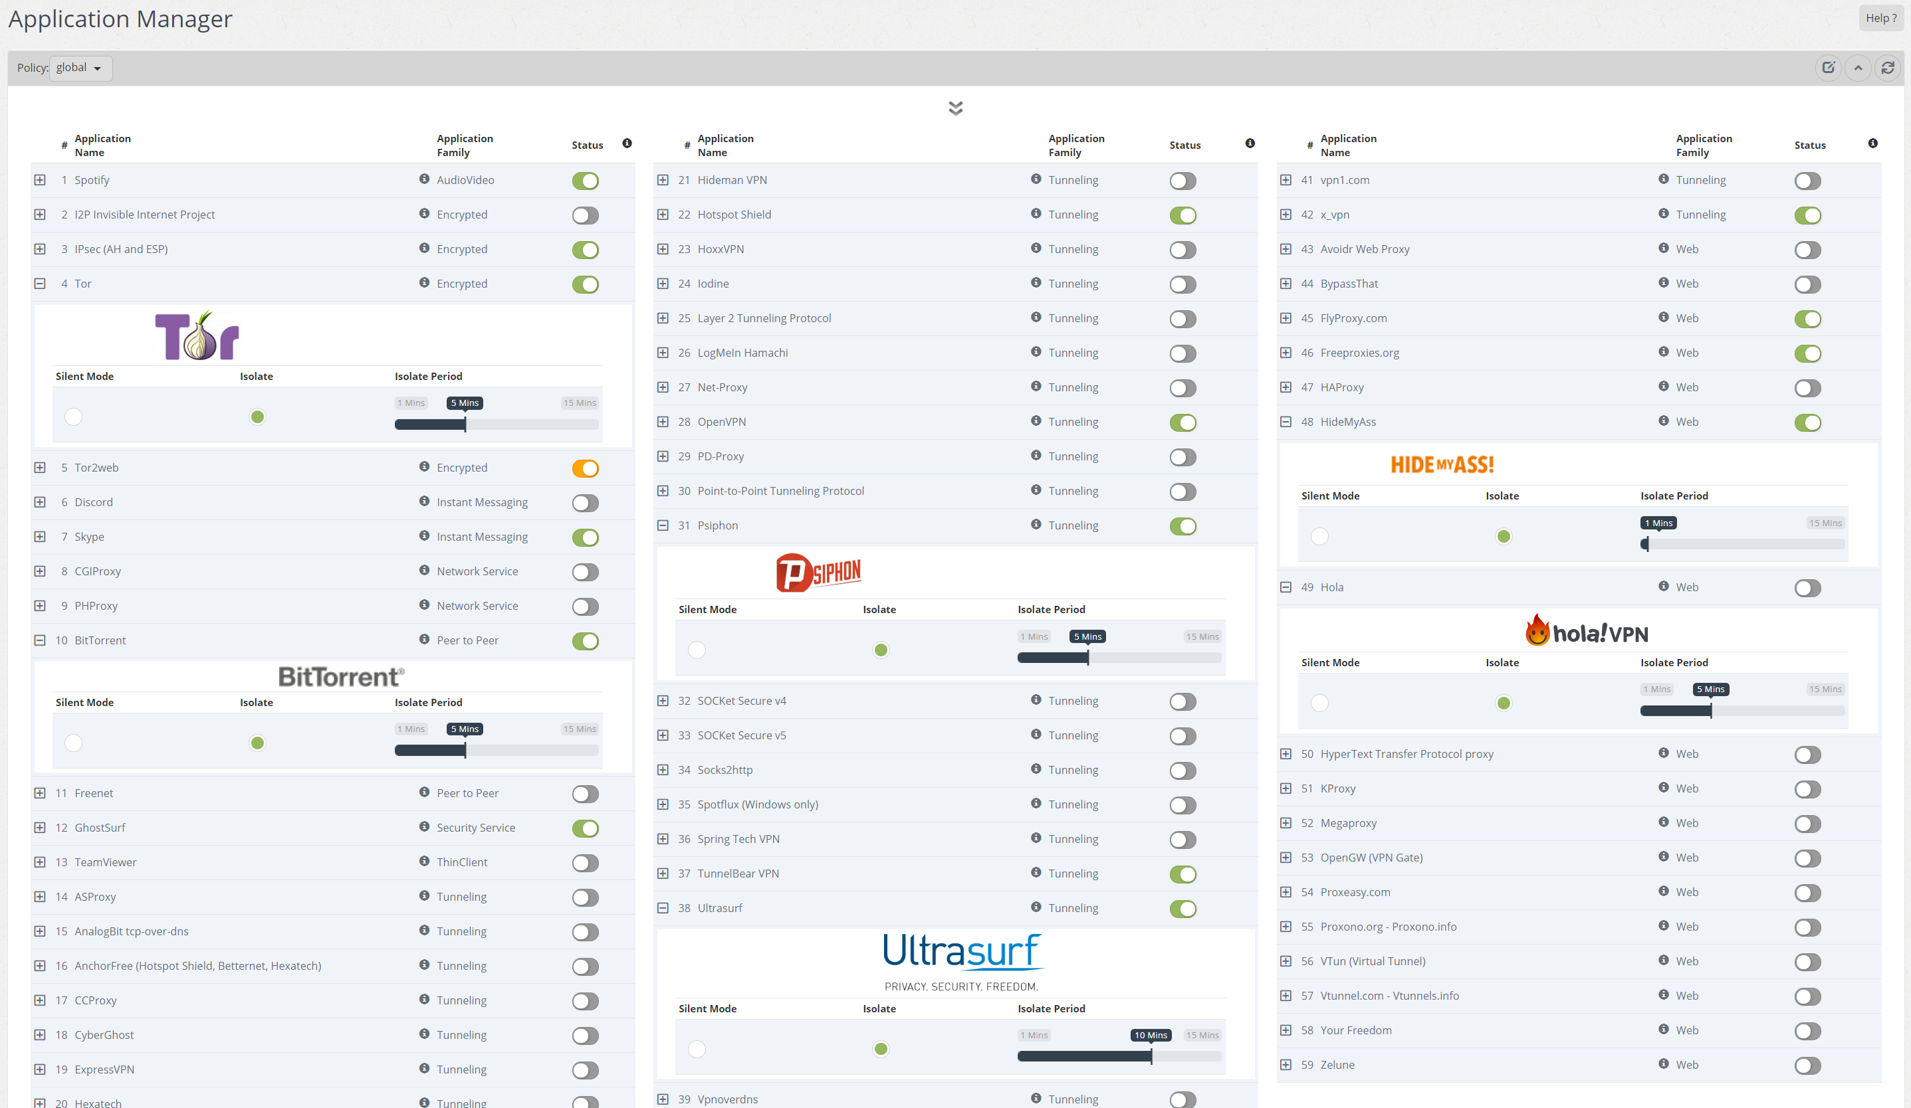
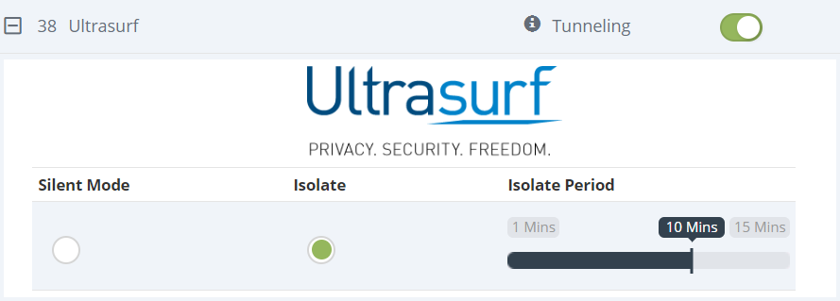
Manage and Control Bad Apps!

Slide 25
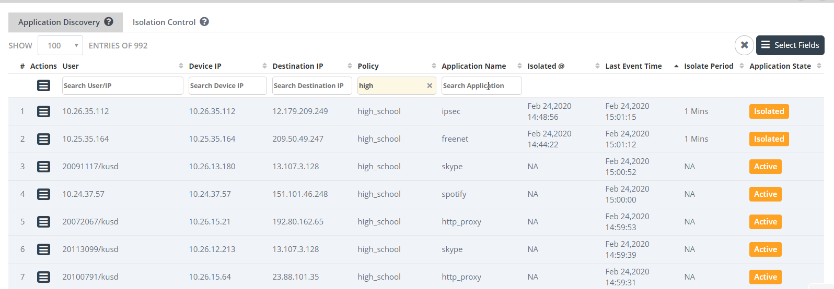
Kenosha Unified School District: Bad Apps Exposed!

Slide 26
Web 2.0 Filtering

Slide 27
Off Site Protection
Student devices go home.
iPads have Global Proxy to force filtering at home.
Chrome devices have an extension installed and are proxied back via the Google Admin Console.
Extension helps identify the user through AD so the correct policy is assigned.

Slide 28
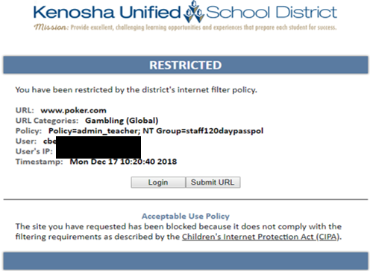
Blocked Content

Slide 29
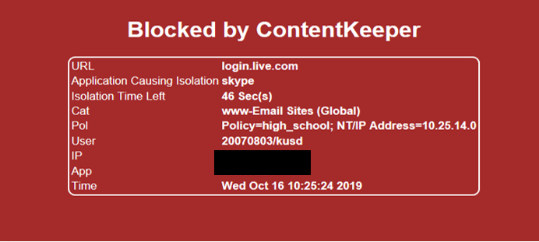
Blocked page for Application Defender

Slide 30
Questions?

